Slide 1
Technical Debt Detection
Rajalakshmi Elumalai
47977765

Slide 2
What is Technical Debt?
A process results in immature, incomplete, or insufficient artifacts in the software development lifecycle process that needs more maintenance costs in future and not suitable for longer run.
It is like a financial debt.
Principal amount – initial code with quality issue
Interest – constant refactor of code/program
Total amount with compound interest – Code accumulated with many quality issues and causes performance to degrade

Slide 3
What is Technical Debt?(continued..)
First introduced by Ward Cunningham in 1993 as
“Phenomena of taking a shortcut to achieve short term development gain at the cost of increased maintenance effort in the future
Technical debt is anything that creates friction between the developer and delivering their work
- Andrea Goulet, CEO at Corgibytes

Slide 4
Causes of Technical Debt
Time constraint
To deliver the software product or features in a short period, developers accept technical dept
The team mainly focus on the functionalities of the software and ignore the performance or quality of the code being developed
Product owners and the development team agrees to launch the first features faster and allocate time to correct the code later to reduce the time to market
Code complexity:
Application is more complex and team is not enough capable to develop complex functionalities, then the team will try hard to bring the functionalities alone and won’t care the software quality/performance.

Slide 5
Causes of Technical Debt( continued..)
Lack of coding standards and guide
Developers implement their own design
Rebuild the same logic over and over which leads to duplication
Format or structure the project, the way they want rather than following the standard one
Programmer with less experience and poor skills
When the team is not having enough experience and good technical skills, there are more chances to not to follow the guidelines and not having more information on latest technologies, they don’t know the best/efficient way to implement a project, then team will face technical debt.
Outdated Technology
As technology evolves, software standards become higher every day. Team is expected to evolve along with new technologies to avoid technical debt.

Slide 6
Impacts of Technical Debt( continued..)
Three kinds of impacts
On individual engineers
On Team
On organization
On customers
On individual engineers
More difficult to add new software
fixing issues become more challenging
Interest on getting motivated about working in the code gets decreased
At extreme situation, engineer will look for career change.

Slide 7
Impacts of Technical Debt( continued..)
On Team
Lower velocity, and greater variance in velocity. Team deliverables get delayed
More rigidity in task assignment
Cannot make any reliable plans or deliverables, as team is not performing well.
On organization
Software assets value get reduced
It will be very difficult to manage the portfolio which runs those assets
Slower and less reliable responsiveness to both customer and team problems
On customers
Dissatisfied customers as they didn’t get expected product
Spending more money to refactor codebase

Slide 8
Technical debt types
Planned Technical Debt
Organization permits to generate some technical debt with the full understanding of the consequences with respect to costs and risks.
Example:
To meet the deadline of the product, the organization made agreement with the client to write the unit test cases after releasing the product instead of writing before releasing the product.
Accidental Technical Debt
It is because of incorrect design and poor practices
When a design is developed without considering future evolution and sustainability, it will be difficult to apply new technology and implement new features

Slide 9
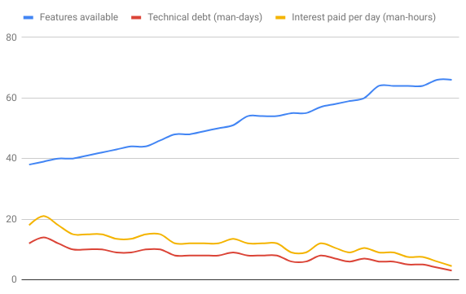
3 common behavior of Technical debt
Eventually Repaid

Slide 10
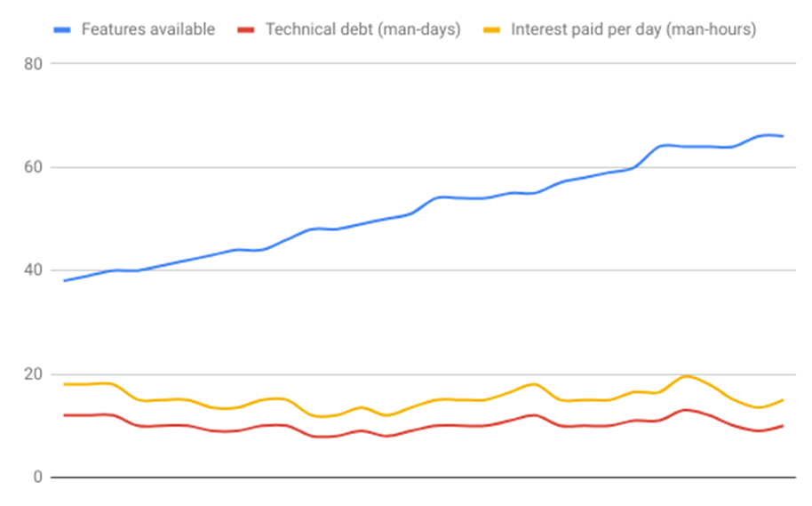
3 common behavior of Technical debt
Sustainable

Slide 11
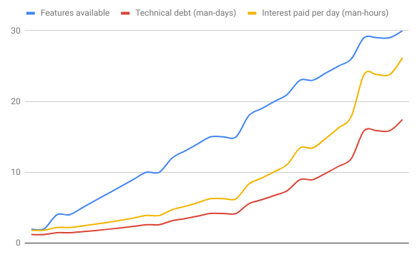
3 common behavior of Technical debt
Compound Growth

Slide 12
 | Eventually Repaid | Sustainable | Compound growth
Type of debt | You eventually repay almost all debt. | You keep debt at the same level by paying off all the interest. | You do not repay debt and interest is added to the debt and debt grows exponentially.
Daily repayment amount | Develop features and refactor the new and old code heavily. | Develop features and refactor the new and old code a bit. | Only developing new features with little to no refactoring.
Daily interest teams pay | Linear, going down. | Linear, constant. | Grows exponentially

Slide 13
Forms of Code -Technical Debt
Code Duplication
Dependency Cycles and Coupling
Writing classes which depends on other classes
Number of circular dependency
Test coverage –
Line coverage -total number of lines that have been hit at least once by a test case
Branch coverage-number of conditional branches like if-else, return statement that have been hit by test cases
Code Complexity – Cyclomatic complexity
Branches, loops, exceptions, return statements, if-else statements

Slide 14
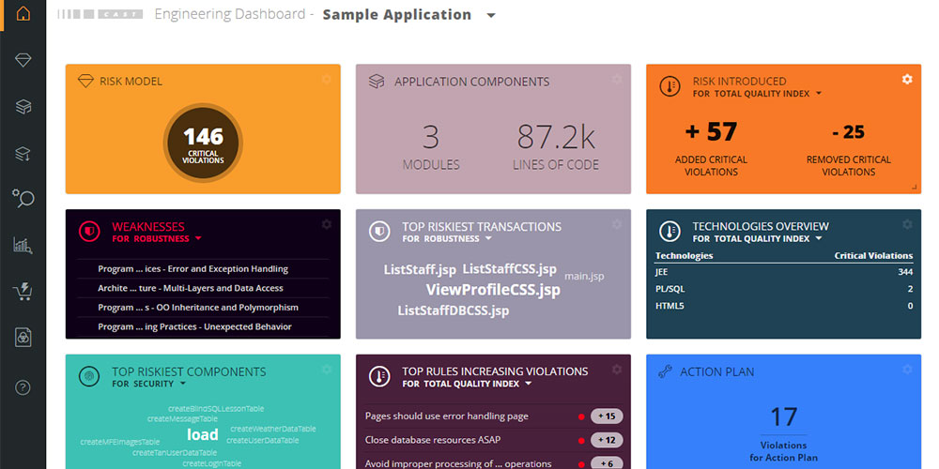
Technical Debt Detector - CAST Application Intelligence Platform
Engineering Dashboard

Slide 15
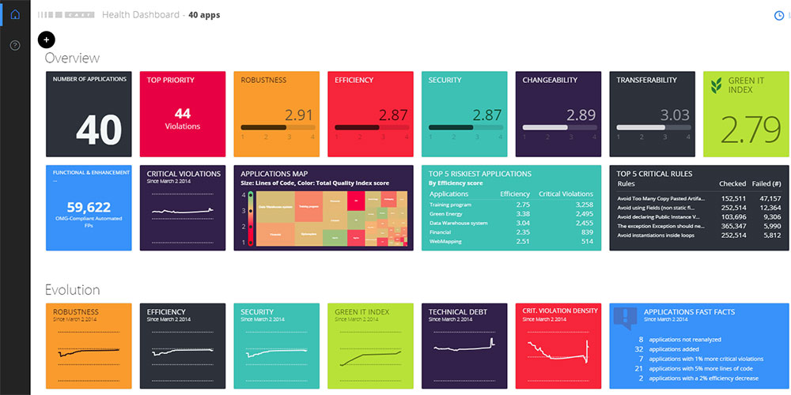
Technical Debt Detector - CAST Application Intelligence Platform
Health Dashboard

Slide 16
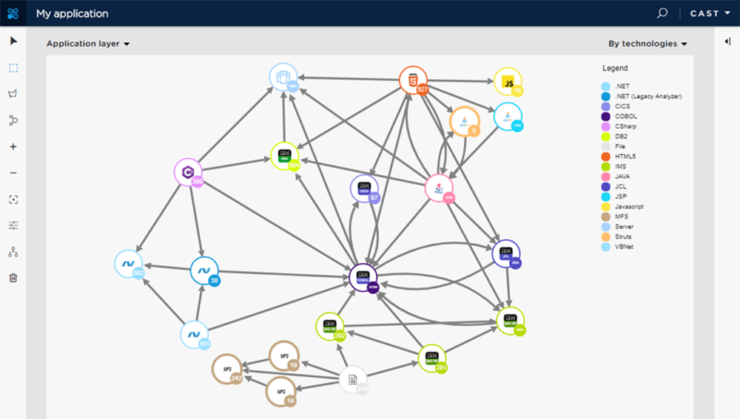
Technical Debt Detector - CAST Application Intelligence Platform
Application Layer/Interaction

Slide 17
Technical Debt Detector - SonarQube
Open source tool provides dashboard visualization for code, tests, design and architecture quality
Mainly designed for java. Later it supports around 25 languages.
Case Study
Java Project - spring-mvc-showcase
Project Link - https://github.com/spring-projects/spring-mvc-showcase.git

Slide 18
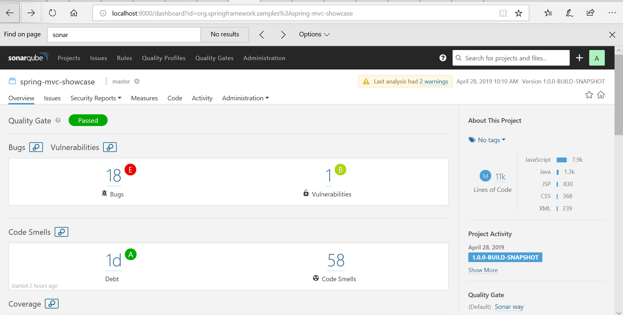
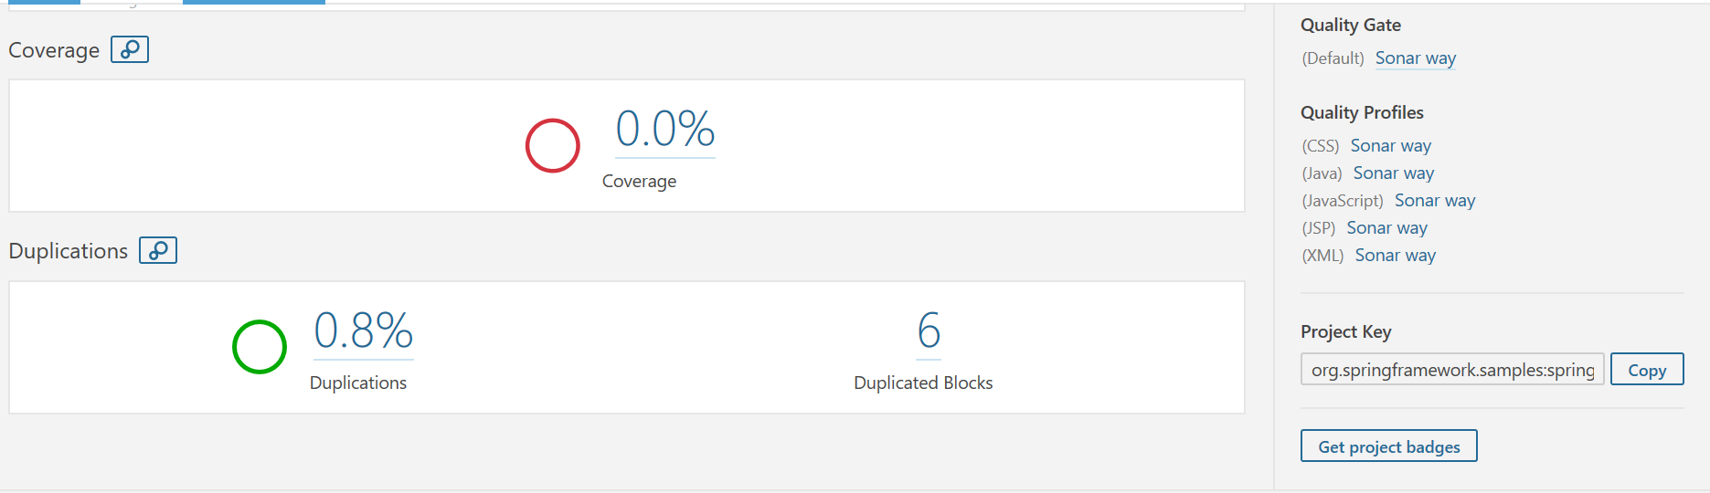
Project Overview

Slide 19
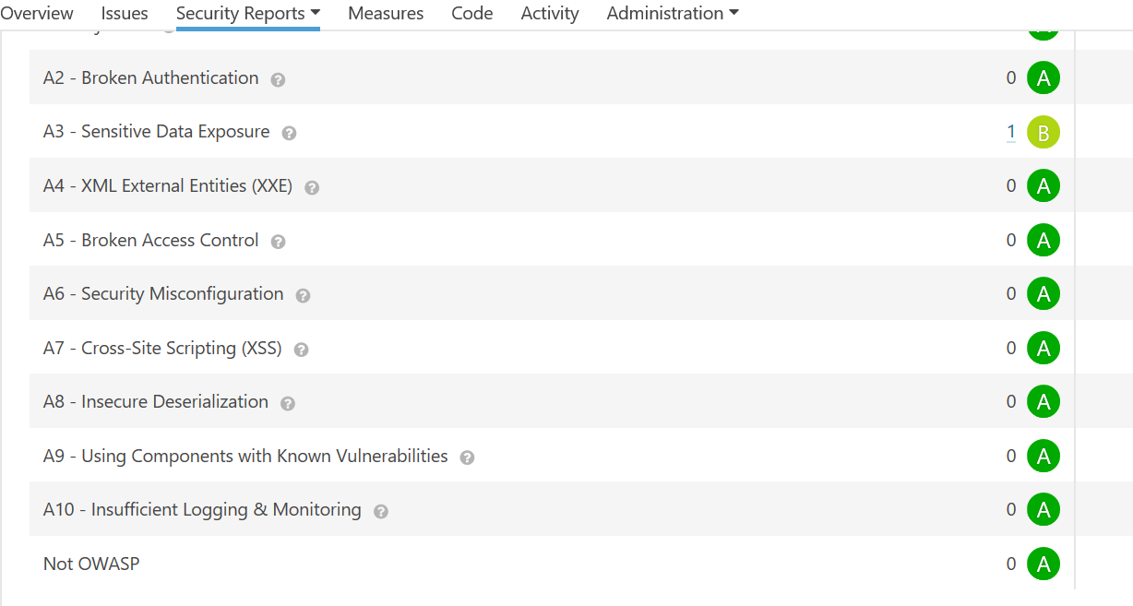
Security

Slide 20
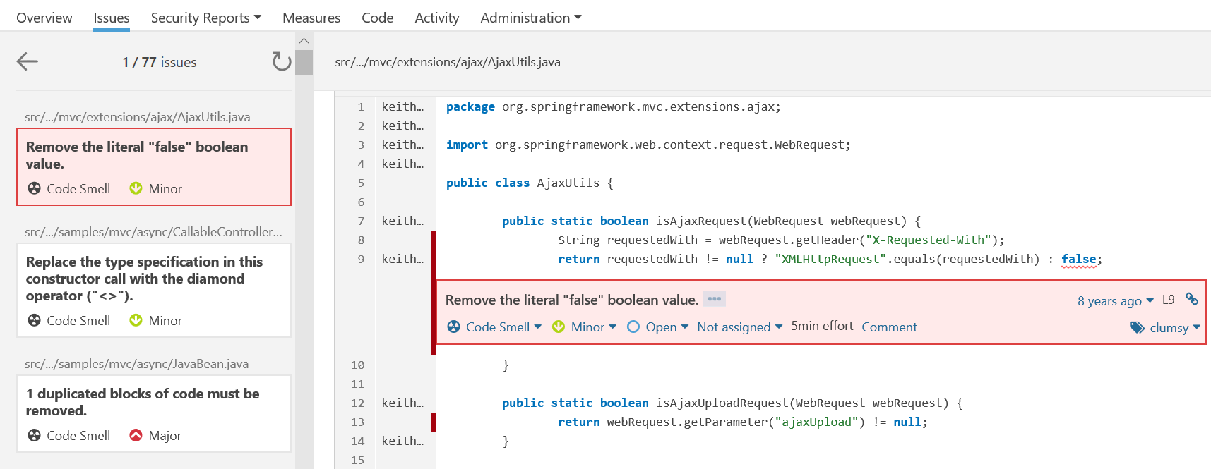
File - issue

Slide 21
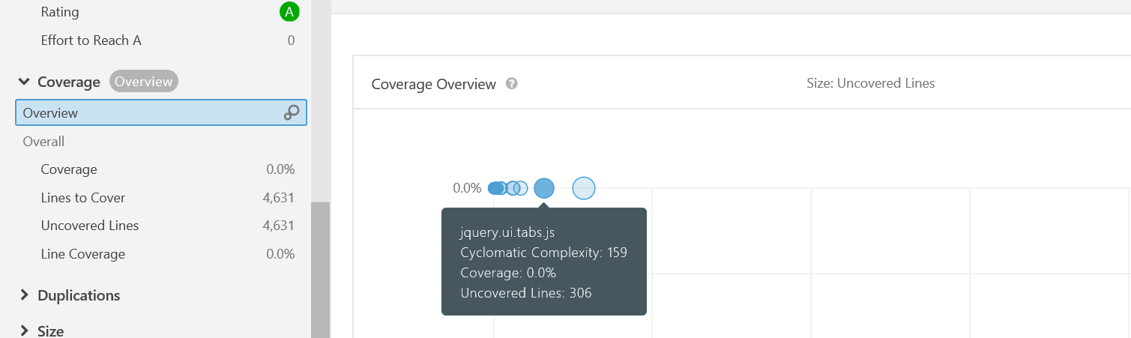
Complexity

Slide 22
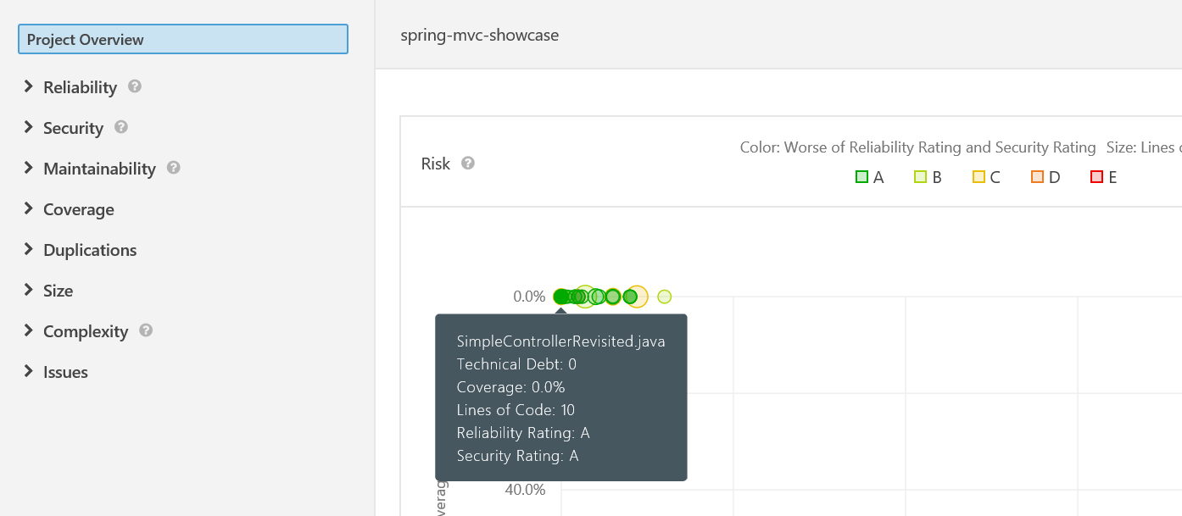
No Technical Debt

Slide 23
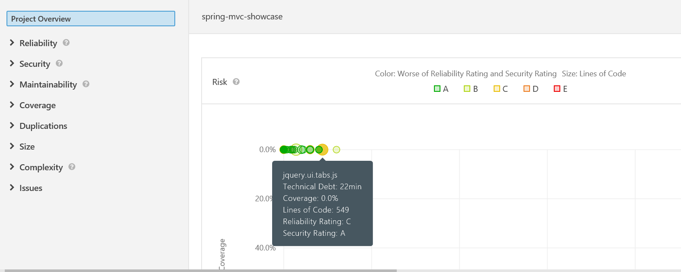
Technical Debt

Slide 24
Technical Debt Detector - SonarLint
SonarLint is an IDE plugin
Helps to detect and fix quality issues as we write code in IDE
Works as a spell checker
Open source plugin
Case Study
Java Project - spring-mvc-showcase
Project Link - https://github.com/spring-projects/spring-mvc-showcase.git

Slide 25
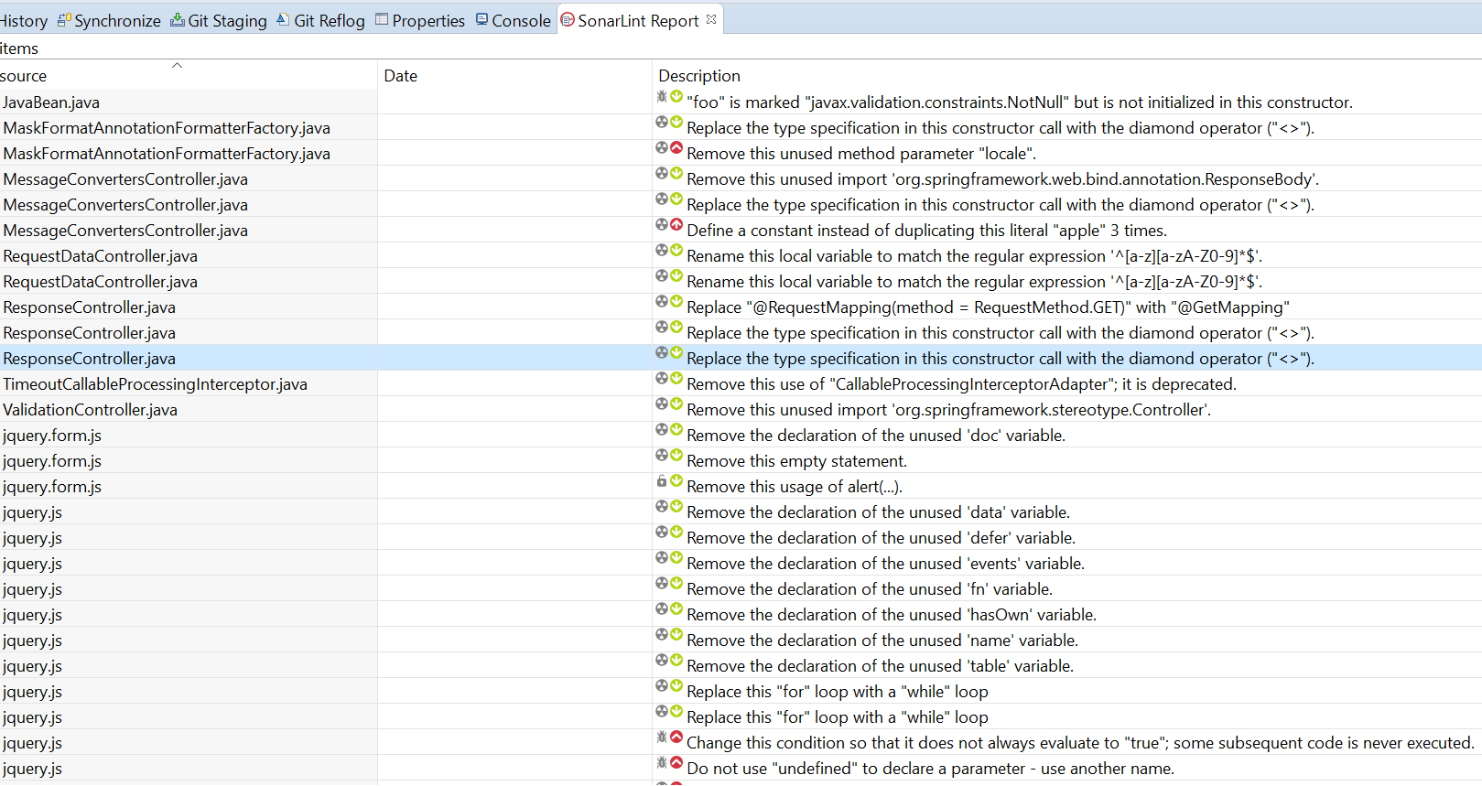
Project overview

Slide 26
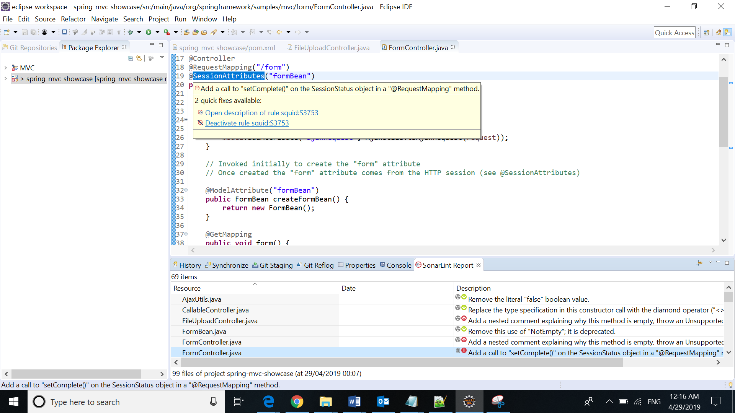
File- Issue

Slide 27
Technical Debt Detector - Teamscale
Teamscale works as plugin in IDE as well as, can configure project in Teamscale server.
Supports many languages including java
Need to obtain license to run. Free license available.
Students can also get free license for a specific time period.
Case Study
Java Project - spring-mvc-showcase
Project Link - https://github.com/spring-projects/spring-mvc-showcase.git

Slide 28
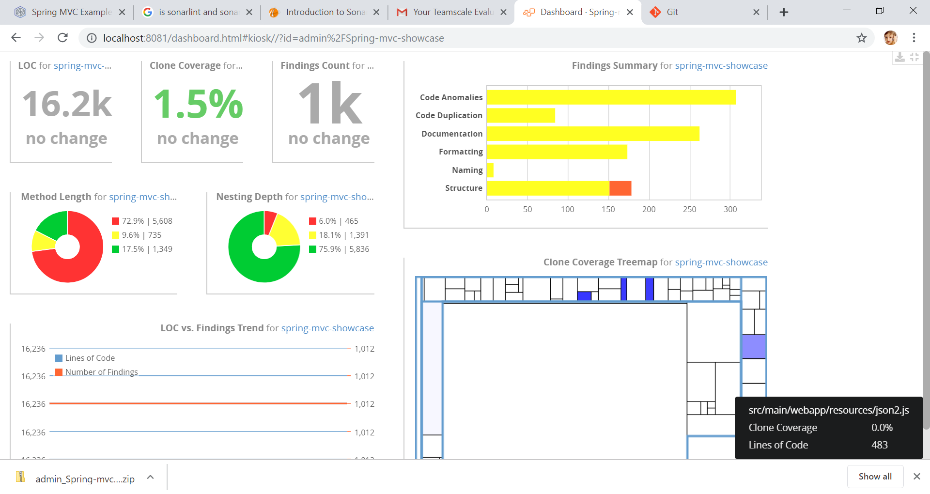
Overview

Slide 29
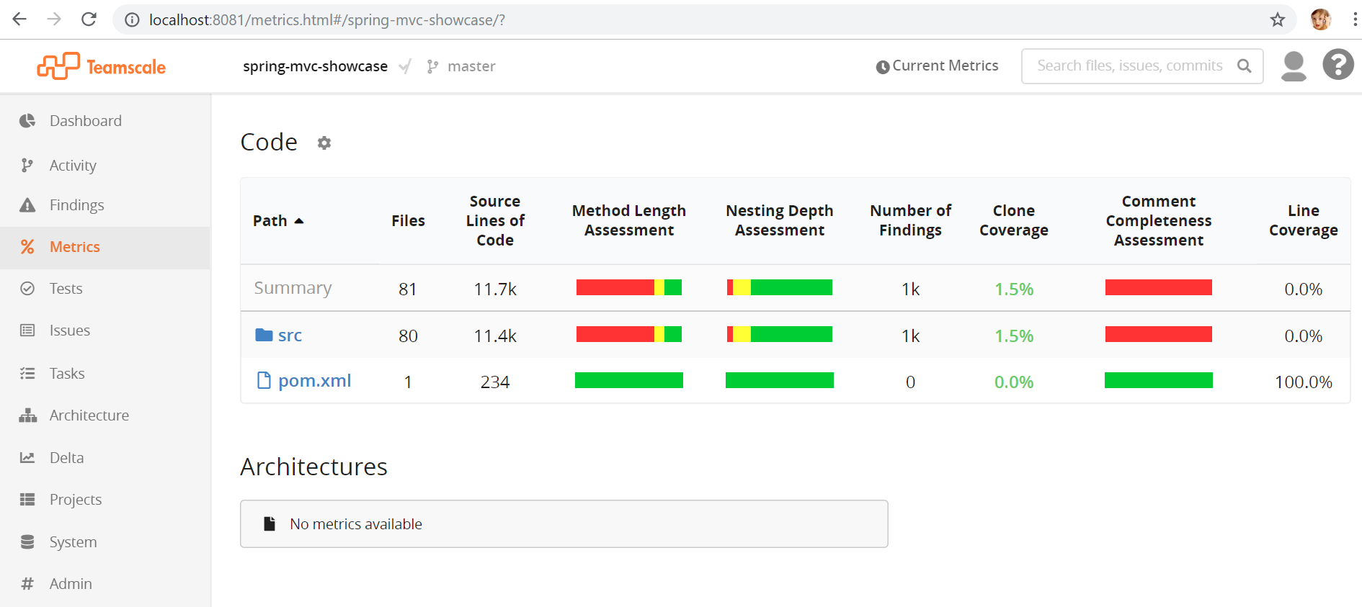
Metrics

Slide 30
Conclusion
Based on the above case studies, If you would like to validate your project with an open source tool, can go for “SonarQube”, as it gives clear picture of the issues and more reliable report.

Slide 31
Thank You ☺

